Slide 1
Falls Free® Wisconsin Coalition Strategic Planning

Slide 2
History Launched in 1st quarter of 2021, with individuals from these initial organizations
Forming the Steering Committee:
Advocate Aurora Health
UW-Health
Greater Wisconsin Agency on Aging Resources
ADRC of Brown County
Safe Communities of Madison and Dane County
Wisconsin Department of Health Services
UW School of Medicine & Public Health
Wisconsin Institute for Healthy Aging

Slide 3
Mission
The Falls Free Wisconsin Coalition is committed to reducing falls among older adults in Wisconsin using a collective impact approach. Made up of community-based organizations such as aging offices and Aging & Disability Resource Centers, health care providers and systems, local falls and injury prevention coalitions, and others, the group is focused on:
Raising awareness of the physical, emotional and financial impact of falls
Identifying and sharing best practices for falls prevention
Engaging in policy and systems change to improve prevention of and response to falls
Collecting and analyzing falls data and providing data customization for local communities

Slide 4
Past Accomplishments
Coalition 1-pager developed
Development of the Coalition Quick Guide (2022)
Coalition website (was on WIHA website, now on FFWI website as of 2023)
Falls Prevention Awareness Month resources & Governor’s proclamation
Falls prevention webinars held for professionals
Coalition membership agreement and growth
Secured federal earmark for falls prevention (2022)
LEAF grants and local projects – reaching underserved populations (2022-2023)
Development of advisory committee and data workgroup (2022-2023)
Launch of FallsFreeWI.org and related resources – including the interactive Home Safety Challenge (2023)
Healthy Aging Grants legislation to support falls prevention efforts
Relationship building statewide and engaging new partners. Strengthened relationships with sectors like public safety
Presentations on initiative at many different meetings and conferences including LeadingAge Conference and 2023 Midwest Injury Prevention Alliance (MIPA) Conference
Earned media tour around the state and paid media reaching more people

Slide 5
Accomplishments 2024
Healthy Aging Grants legislation – bipartisan support & awareness
Earned media campaigns (winter safety, physical activity, hunting safety, FPAM)
Falls Prevention Awareness Month placemat contest (8 submissions)
Falls Prevention Awareness Month event calendar (15 submissions)
Paid ads (social media, Hulu, YouTube, Spotify)
Received NCOA Innovation in Falls grant
Consumer webinars held and well attended
May webinar (physical activity): 80+ registered, 29 attended live, 108 views of recording
September webinar (home safety): 195 registered, 58 attended live, 49 views of recording
Newsletter to subscribers (257 subscribers as of 11/6/24)
Adapted materials for tribal communities (Packers Foundation Grant)
Made improvements to FFWI website (Home Safety Challenge, best practices list, etc.)
Attended the National Falls Prevention Summit to help update the national falls prevention action plan
Shary Perez received National Falls Prevention Fellowship from NCOA
Other?
Notes:
Wisconsin is being looked at as a leader in falls prevention

Slide 6
2025 Funding Projection
Will look a little different in 2025
National funding:
Earmark funding ended 8/31/24.
Projected ACL grant to fund state falls coalition should be released in the next few weeks
State level funding/investment:
Healthy Aging Grants legislation cut short in 2024
Will continue & reintroduce bills in 2025
Will also advocate for getting into Governor’s budget
Corporate support
Share contacts with WIHA for corporate sponsors/donors
Notes:
Jill provide funding overview/projection

Slide 7
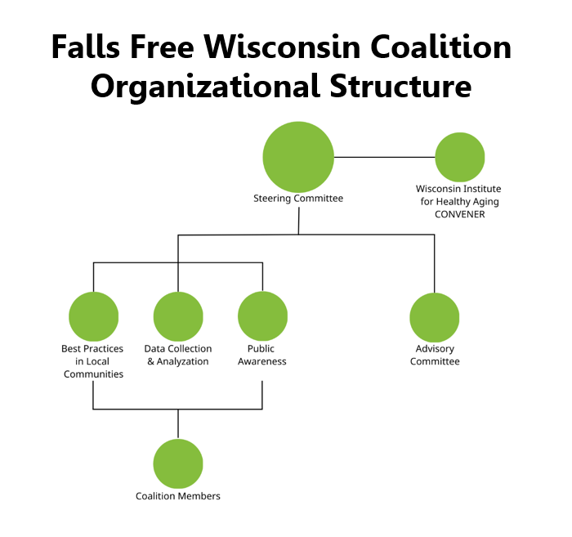

Slide 8
Structure
Coalition Members
Meet on an as-needed basis with email communication (1-3x/month) in between meetings.
Advisory Committee
Meets quarterly or on an as-needed basis with email communication in between meetings if necessary.
Engaged to gather feedback on workgroup activities, consult with on coalition activities, discuss adapting coalition materials for different populations and provide advice on coalition deliverables.

Slide 9
2025 Strategic Planning
Steering Committee
Founding organizations and chairs of the workgroups meet bi-monthly to share strategies and coordinate action plan.
Provides leadership for policy initiatives.
2024 Steering Committee Priorities:
Continue to grow membership of the coalition
Ensure coalition is representative of the communities (Advisory Committee)
Policy & systems change initiatives
Healthy Aging Grants (HAG) legislation
Healthcare project

Slide 10
2025 Strategic Planning
Public Awareness and Education Workgroup
Meets monthly to plan and implement public education efforts to generate awareness of the falls problem and falls prevention strategies.
Manages Falls Prevention Awareness Month efforts.
2024 Public Awareness & Education:
Year-round falls prevention earned media campaigns & paid ads
Consumer webinars
Partner reach-out & share with consumers
Improvements to Home Safety Challenge
Falls Prevention Awareness Month activities
Presentations to partner organizations
Newsletter to FFWI subscribers (quarterly) & coalition partners (as needed)
Adapt materials for tribal communities (Packers grant project)

Slide 11
2025 Strategic Planning
Best Practices in Local Communities Workgroup
Meets bi-monthly to develop strategies and tactics to support local communities.
Manages a quarterly call with local coalitions focused on technical assistance needs including identifying and addressing areas of challenge, sharing best practices, and creating strategic partnerships among coalitions in the state.
2024 Best Practices in Local Communities:
Scale up FFWI best practices/programs list
State Falls Prevention Quarterly Collaborative
Innovation in Falls Prevention/EMS (NCOA grant project)

Slide 12
2025 Strategic Planning
Data Collection & Analyzation Workgroup
Meets bi-monthly to analyze data and plan to display data in a way that is meaningful and understandable for professionals and consumers.
Uses data to drive prevention strategies.
2024 Data Collection & Analyzation:
Collect, analyze and share data
Provide education to partners
Solicit for technical assistance and data customization

Slide 13
Challenges
Member and partner capacity
Missing members
Consumers
Caregivers
Housing
Etc.
Funding/sustainability

Slide 14
2025 Strategic Planning
Advisory Committee Feedback
Qs: What are your top falls prevention priorities in the next year? What are you hearing from older adults/seeing locally?
Give as many presentations in the area as possible & follow up with programs that can help (SO/Tai Chi…)
(UW Health/Safe Communities) Falls prevention as initiative in injury/safety priority- how older adults can have at least 1 annual TUG screening. Exercise routine planning. Providers refer to facilities
Transportation is a barrier
Expanding SO program -> recruit more facilitators
Expand to Hmong community
Forming falls prevention coalitions with hopes of implementing referral program (b/t EMS & ADRC)
Age Better Inc (Dane Co) – home safety assessments (falls prevention huge component)
A lot of need around equipment & reliable contractors to make modifications/where to go to get certain types of equipment – resource hub? Certified aging in place specialist? Know how to properly install a grab bar, etc
Getting more of the classes certified as “Balance Stamp of Approval” because not everything is evidence-based (ex: water based)

Slide 15
2025 Strategic Planning
Advisory Committee Feedback
Qs: What activities should we focus on in 2025? What is the need? What does sustainability look like?
Legislative actions
Funding to support home modifications/adaptive equipment
Talk to officials about bus services/transportation options – highlight best practices (FitchRona working on this in initial stages)
EMS legislation
Integration with healthcare systems – referrals/education?
Signing up for falls clinics (long waitlists). Have turned to SO
Education: how to fall safely, how to get up from a fall (included in SO- include in marketing for SO?)
Including an optional display handout in SO for FFWI
More home safety assessments for those who don’t qualify for home health, especially for those living in hard-to-reach communities
Can’t afford to pay for lifeline/other services- finding funding for these (highlight in HAG)
Information on how technology can support fall prevention

Slide 16
2025 Strategic Planning
Discussion
Qs: What activities should we focus on in 2025? What is the need? What are the gaps? What does sustainability look like?
Who else should be at the table?
Does the coalition structure still match the
needs of the group? Do we have the right workgroups?

Slide 17
2025 Strategic Planning
Qs: What activities should we focus on in 2025? What is the need? What are the gaps? What does sustainability look like?
FPAM – customizable materials
FPAM events calendar (promote more and start promoting earlier)
Presentations on FFWI/falls prevention – awareness of resources that exist
HAG legislation & keep our eyes on other opportunities to share our voice (ex: EMS/falls)
Integration into other groups (EMS advisory board, statewide trauma advisory council)- asking for agenda items or show up and share during public comment
(specific asks are better – ex: write a letter to the governor’s office)
WIVIPP is doing strategic planning – get into this group
Statewide learning/platform to bring everyone together (webinars, meetings, etc.)
Healthcare integration – statewide referral? (idea: CHNA – look at hospitals that have indicated falls/improving lives of older adults as a priority- WHA does a summary of this?)
How you can advocate using healthy people 2030
Data analyzation
Pull out parts of Stepping On – (ex: exercises, getting up from a fall) to provide education and refer to EBP (topic-specific education)
Education for people with disabilities to prevent falls (ex: cerebral palsy)
Learn what other states are doing – are there things states are doing really well we could learn from?
Make people aware of our resources & what we’re doing

Slide 18
2025 Strategic Planning
Qs: Who else should be at the table?
Elected officials
Legislative support (local/state/city manager/mayor)
Related to transportation
Home health agencies
Annual wellness visits- PCP/physician
Wisconsin Nurse Association
Wisconsin PT/OT Associations
Senior centers -> WASC
AARP
Community organizations providing balance exercises for falls
Churches
Caregivers -> assisted living facilities
Libraries
Meals on Wheels programs
Rotary Club -> civic groups
Pharmacy Association
BIPOC – Madison Senior Center
EMS advisory board, statewide trauma advisory council
ORCHID
Researchers
Older adults -> people who have fallen

Slide 19
2025 Strategic Planning
Qs: Does the coalition structure still match the needs of the group? Do we have the right workgroups?
Revitalize workgroups
Have a specific project to rally behind for each workgroup
Embed advisory committee members into workgroups
If they’re OK with it? Extend an invitation to join a workgroup
Look @ priorities
Embed policy work into awareness workgroup or its own workgroup?

Slide 20
Goals for 2025 – Brainstorming
Steering Committee:
Look @ lists of people to add to coalition & come up with contacts
Learn what other states are doing – are there things states are doing really well we could learn from?
Integration into other groups (EMS advisory board, statewide trauma advisory council)- asking for agenda items or show up and share during public comment
(specific asks are better – ex: write a letter to the governor’s office)
WIVIPP is doing strategic planning – get into this group
Public Awareness & Education:
FPAM – customizable materials
FPAM events calendar (promote more and start promoting earlier)
Presentations on FFWI/falls prevention – awareness of resources that exist
Statewide learning/platform to bring everyone together (webinars, etc)
Make people aware of our resources & what we’re doing
Advocacy
How you can advocate using healthy people 2030
HAG legislation & keep our eyes on other opportunities to share our voice (ex: EMS/falls)
Strategize and help with mobilization – make direct asks and physically talk with representatives and ask other people to do that
Put invite out & if nobody interested put back into steering committee?
Ask WAAN
Put out in GWAAR digest
Ask on quarterly health promotion webinar in 2 weeks
Put in next FFWI newsletter

Slide 21
Goals for 2025 – Brainstorming Continued
Data Collection & Analyzation:
Release alcohol/falls data report
Data analyzation
UW Pop Health?
WIVIPP is hiring an epi?
Integrating national data into what we currently have
Falls data dashboard
BRFSS data focusing on older adults? Carlie Malone
Ask Will (DHS) to join/coordinate? Put on hold if Will doesn’t have capacity
Best Practices in Local Communities:
Pull out parts of Stepping On – (ex: exercises, getting up from a fall, disabilities) to provide education and refer to EBP (topic-specific education)
Healthcare integration – statewide referral? (idea: CHNA – look at hospitals that have indicated falls/improving lives of older adults as a priority- WHA does a summary of this?)
Innovation in Falls EMS/CBO toolkit
Put on hold for now
Advisory Committee:
Ask to join workgroups and discontinue Advisory Committee if members are OK with it. Don’t want to lose their voices.

Slide 22
2025 Next Steps/Tentative Plan
Steering Committee:
Work on expanding the coalition and reaching/integrating into different groups
Best Practices in Local Communities:
On hold for now
Continue state quarterly calls
Public Awareness & Education:
Continue FPAM activities
Continue presentations & making people aware of our resources & what we’re doing
Continue webinars & learning opportunities
Data Collection & Analyzation:
Ask Will Koehne from DHS to help coordinate/lead. Put on hold if doesn’t have the capacity.
*NEW* Advocacy:
Invite people to join and if no one is interested, embed back into Steering Committee
Strategize and help with mobilization of HAG – make direct asks and talk with representatives
Advisory Committee:
Embed members into the coalition and ask them to join workgroups. If OK, discontinue committee.

