Slide 1
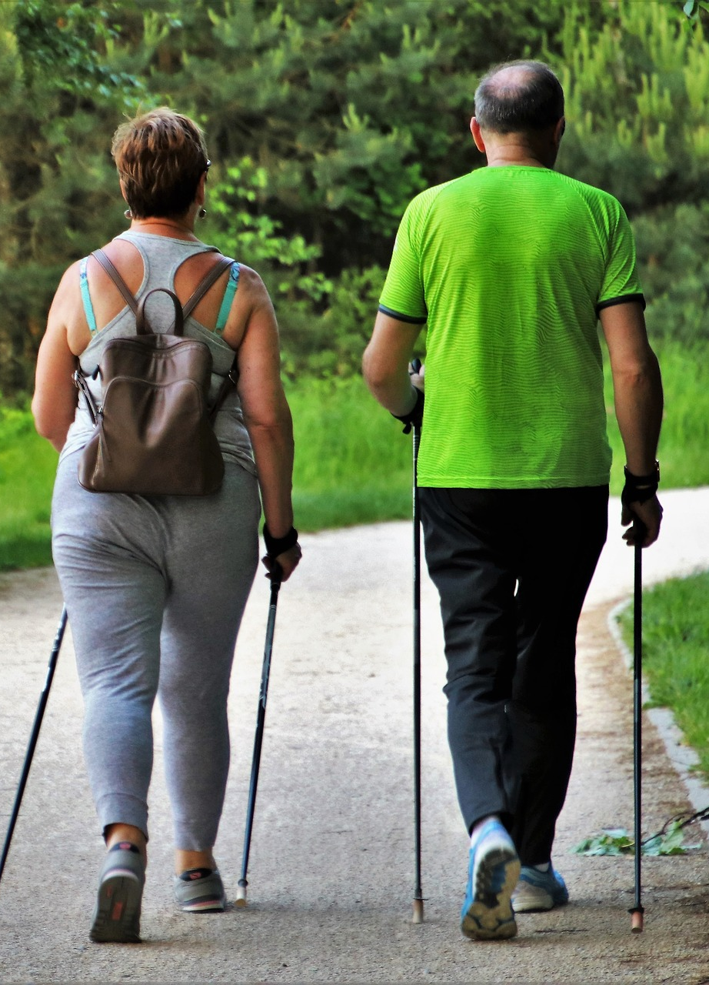



Feet First
Preventing Falls
Presented by:
Michelle Erdmann, Program Manager
Aging & Disability Center of Brown County
Kristin Paluch, BSN, RN
HSHS St. Vincent Hospital
Notes:
*Presenter to add their name and credentials
*Presenter can add their agency logo (replace ADRC), but must keep Brown County Fall Prevention Partnership logo

Slide 2
Introductions
Anyone have an experience to share about a fall?
Notes:
Presenter: Does anyone have an experience regarding falls that they would like to share?
*Allow for approximately 5-7 minutes of sharing
*Follow up the story with an open-ended questions such as:
- What did you learn from that experience?
- Was there anything you did differently after your fall?

Slide 3
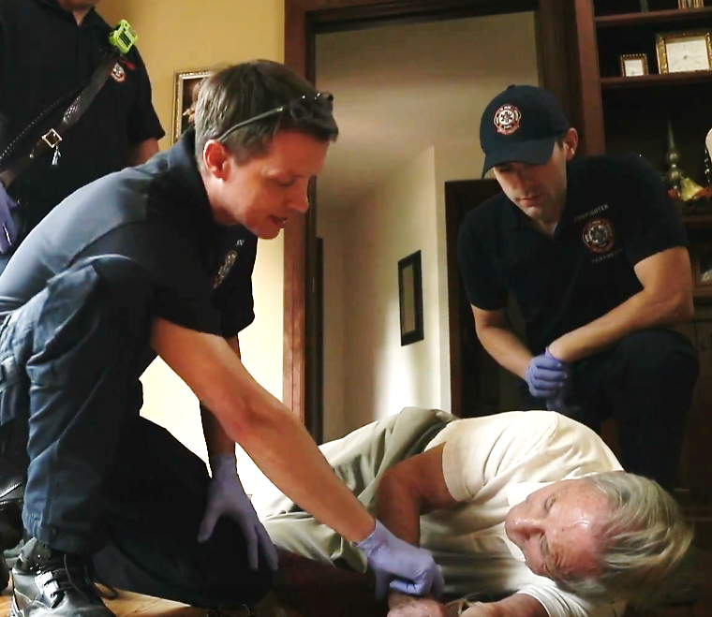
Why Falls Prevention
Local statistics
Review key areas and action you can take to reduce your falls risk or that of a loved one
Resources available
Notes:
Presenter: This is the framework for today’s discussion. We’re (I’m) also eager to hear your thoughts on how our community can better educate on fall prevention.

Slide 4
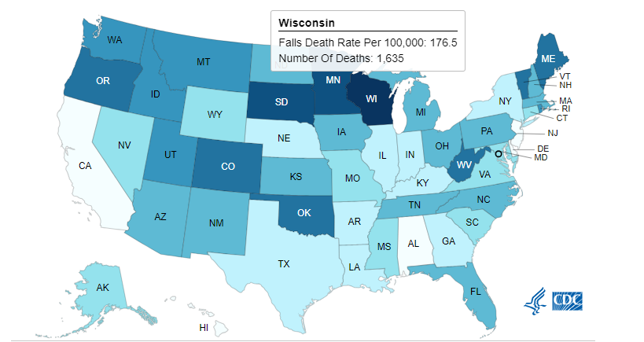
Highest Rate of Death from Falls
WISCONSIN
Data source: Centers for Disease Control and Prevention. National Center for Health Statistics. National Vital Statistics System, Mortality 1999–2021 on CDC WONDER Online Database. Accessed January 24, 2023. https://wonder.cdc.gov/ucd-icd10.html
Notes:
Presenter: This diagram highlights states with the highest rates of fall-related deaths, indicated in darker blue. Both Wisconsin and Minnesota are ranked among the highest.
According to the Centers for Disease Control and Prevention (CDC), Wisconsin has the highest fall death rate among older adults in the United States. Falls not only lead to fatal injuries but can also result in long-term health conditions stemming from injuries or a loss of confidence in one’s physical fitness.

Slide 5
Falls: Top Trauma Injury in Northeast WI
53% of all trauma injuries in Northeast WI are falls
Source: Reported 4.29.2022 by Katie Prather, Trauma Registry Data Manager, Wisconsin Department of Health Services (Region 3 - Northeast WI)
Notes:
Presenter: This statistic represents ER visits for trauma-related incidents.
The next highest percentage is due to vehicle accidents, at 14%.

Slide 6
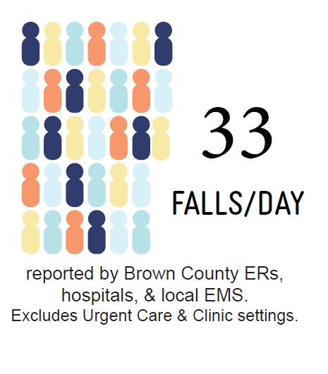
Brown County 2023 - Average Falls/Day
Admitted to GB ER
Admitted to GB hospital
Called 911 for help getting up from a fall
Source: Wisconsin Hospital Association, reported by Chery Czech, 5.15.2023 using iAnalyze Market Share and Brown County EMS departments. Does not include those presenting at clinic or Urgent Care setting.
Notes:
Presenter: On average, there were 33 falls per day in Brown County during the calendar year of 2023. This includes:
7,809 admissions to the Green Bay Emergency Room due to falls
Admissions to the Green Bay (inpatient) hospital because of a fall
Calls to 9-1-1 for assistance in getting up after a fall (reported by Green Bay Metro FD, Ashwaubenon Public Safety, Bellevue FD, Howard FD, County Rescue, and De Pere FD)
This number does NOT include falls that resulted in visits to Brown County Urgent Care or Brown County health clinics.
Optional, if Fire Department is with:
Green Bay Metro Fire Department went on 17,000 calls in 2023, which includes fires, car accidents, etc. Out of those calls, the #1 call, totaling 2,500, was for fall-related incidents.

Slide 7
Why so Many Falls -
Common Things We Do
Wearing inappropriate footwear or clothing
Not utilizing appropriate assistive devices (such as a walker or cane) or misuse of these device
Not using or misuse of railings or grab bars
Not utilizing or installing appropriate lighting
Not having our vision checked regularly, missing a step
Using rugs that are too thick or not using proper placement of rugs
Unaware of our surroundings such as grandkids, pets and other objects underfoot
Distracted and not paying attention to where we are walking, and scanning ahead
Rushing or getting up too quickly
Other common things we do:
Using unsafe, unstable elevation to reach things (ladder, chair, bed, tub, sofa, step stool)
Carrying too many things in our hands and can’t catch ourselves if we get off balance
Notes:
Presenter: We’ve discussed the statistics on the number of falls. Now, we’ll delve deeper into the causes—beyond just attributing it to the Old Fashioned (drink). First, we’ll explore the common or careless actions we take.
According to the CDC, about $50 billion is spent on medical costs related to older adult falls each year. For non-fatal falls, an estimated $29 billion is paid by Medicare, $9 billion is paid by Medicaid, and $12 billion is paid by private or out-of-pocket payers.
Falls occur in all age categories, but simply put, as we age, we become less agile and more fragile. The cost of a fracture due to a fall outweighs the cost of most simple changes to prevent a fall.

Slide 8
What Can We Do to Eliminate Our Risk for Falls?
Notes:
Presenter: While the local statistics may seem stacked against us as we age, there are simple actions we can take now to reduce our risk. After all, we all want to avoid the life-changing consequences of a broken bone that too often results from a fall.

Slide 9
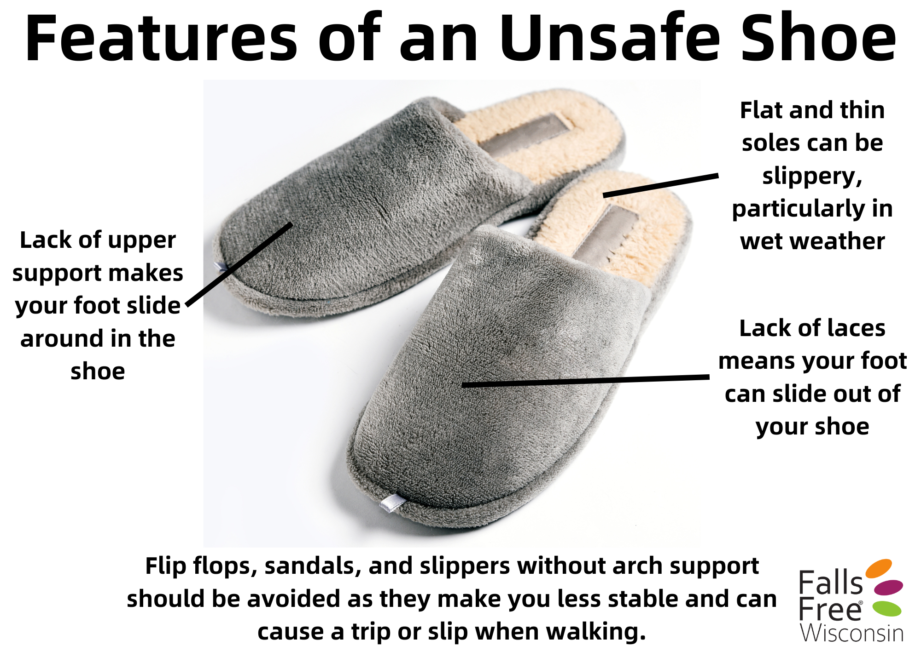
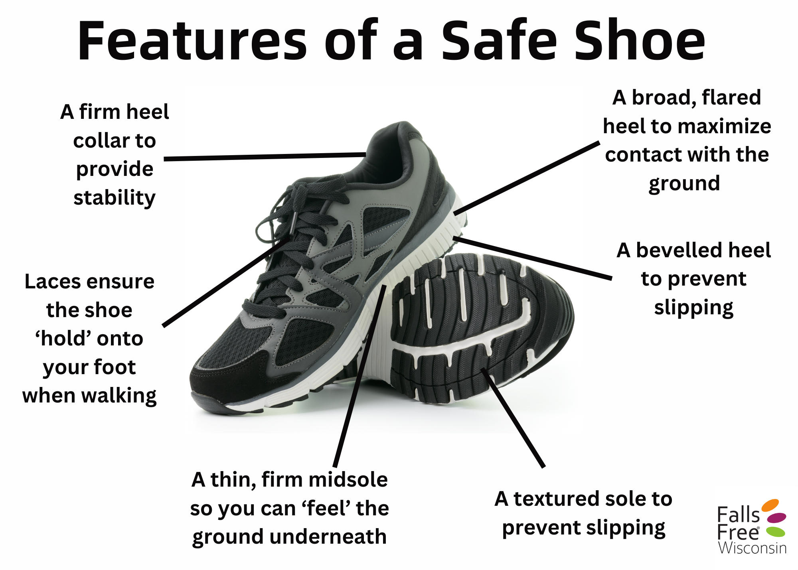
Why so Many Falls -
Common Things We Do
Wearing inappropriate footwear or clothing
Notes:
Presenter: Many of us have a favorite pair of worn-out house slippers or walk barefoot in our homes, but having good support underneath us can make all the difference. Wearing unsafe shoes can put you at risk of a fall. Think comfort over fashion in this case!
Studies show that there are a few factors that you should keep in mind when thinking about your feet and footwear:
Barefoot versus wearing shoes: Wearing shoes can reduce the risk of a fall, even while inside, as shoes provide more grip and protect from changes in flooring surface.
Keep your shoes strapped on: Wear shoes with laces, straps, or buckles to keep your feet in place.
Shoes are like tires – they have tread: Well-loved shoes with smooth tread have decreased traction and can increase the risk of a fall. Over time, the tread on our shoes tends to wear out. Replacing our shoes with worn tread is important. Wearing shoes with thin, hard soles can help us “feel” the ground underneath our shoes, making it easier to detect changes in flooring surface.
Foot health: As we age, our feet change! We may get thinner, dryer skin and may lose strength in our feet and toes, which we use for gripping as we walk. We may have less range of motion in our ankles, and be more likely to have dropped arches and flat feet.
All of these factors can affect the way we walk or impact our balance, which can lead to a fall. Are you having problems with your feet? Don’t forget to mention any issues to your provider at your next appointment.

Slide 10


Why so Many Falls -
Common Things We Do
Wearing inappropriate footwear or clothing continued…
Notes:
Presenter: Loose clothing, like items with large open sleeves, big belt loops, or dresses, can easily get caught in doorways or handles. Additionally, items such as purses with handles left on the floor or long pant legs can trip you up.

Slide 11
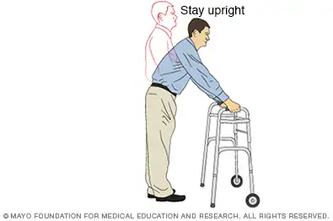
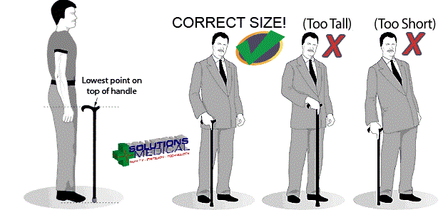
Why so Many Falls -
Common Things We Do
Not utilizing appropriate assistive devices (such as a walker or cane) or misuse of these device
Notes:
Presenter: Many people misuse assistive devices due to lack of training, improper fitting, stigma, or inadequate information. This can lead to improper usage, potential injuries, and reduced benefits.
There are various types of canes and walkers, each suited to different needs based on strength, balance, and fitness level. Canes help with weak or painful lower extremities, while walkers assist those who are unsteady. Consult with your provider to choose the right device and learn how to use it correctly; they may refer you to a physical therapist.
In icy Wisconsin winters, ice tips can be added to canes for better traction and stability.
Do you use a cane or walker in your home? Do you think ‘I don’t need that yet’. Well, when is “yet”? Start to think one step ahead.
________________________________________________________________________________
Presenter should view these clips prior to show basics knowledge of how to use walker and cane properly:
How to use a walker correctly: https://youtu.be/dQN4rt_v5SU
How to use a cane correctly: https://youtu.be/E_WB33oS93s

Slide 12
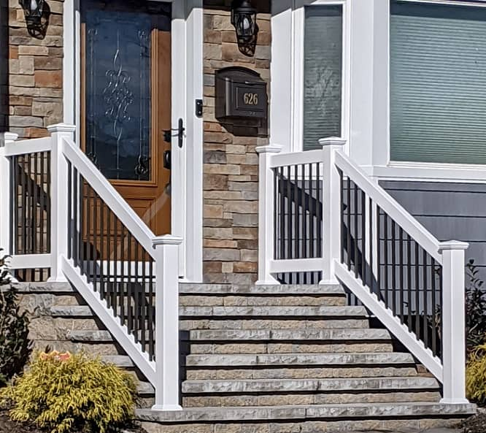
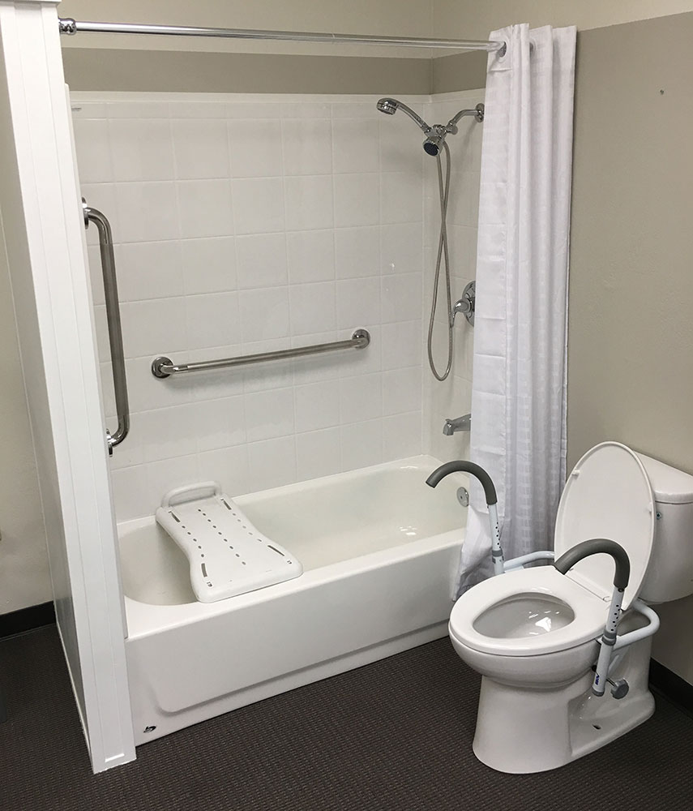
Why so Many Falls -
Common Things We Do
Not using or misuse of railings or grab bars
Notes:
Presenter: Misusing railings and grab bars can lead to falls, as they may not provide the necessary support if not properly installed or used correctly.
Handrails: Should be available wherever there are steps, such as at the front and back doors and all staircases. Ideally, have handrails on both sides for added safety.
Grab bars: Install in places where you may lose balance, ensuring they’re professionally installed at the correct height and securely attached to the wall. Avoid suction cup grab bars. Recommended placement includes three grab bars in the shower and bathtub (one at the entrance, one on the inside wall, and another by the faucet handles).
Additional placement for grab bars:
At the front door for balance while unlocking the door, especially if it’s slippery or icy.
At other home entrances like the garage and back door.
Note: Towel racks are NOT grab bars, but grab bars can function as towel racks. Options that don’t require drilling and come in various styles are available.
Other recommendations:
Install a bed rail for support getting in and out of bed.
Use a hand-held shower head to avoid reaching or straining, and consider a shower chair for additional support.
Add a raised toilet seat or a seat with handles for extra stability in the bathroom.

Slide 13
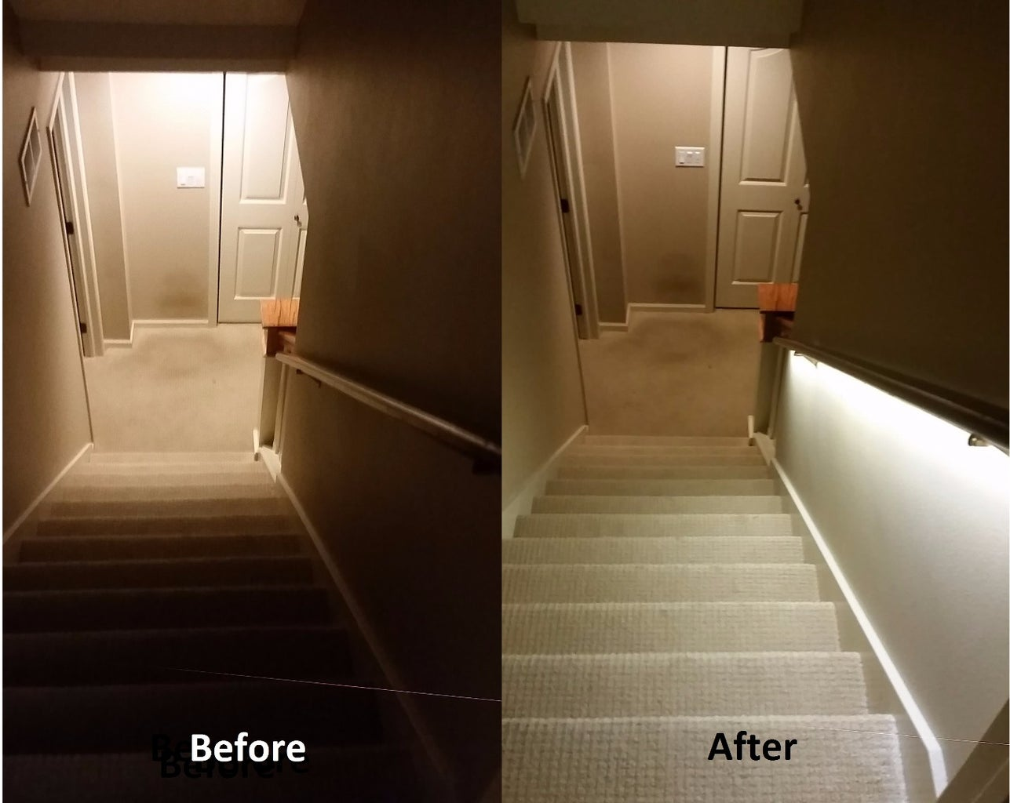
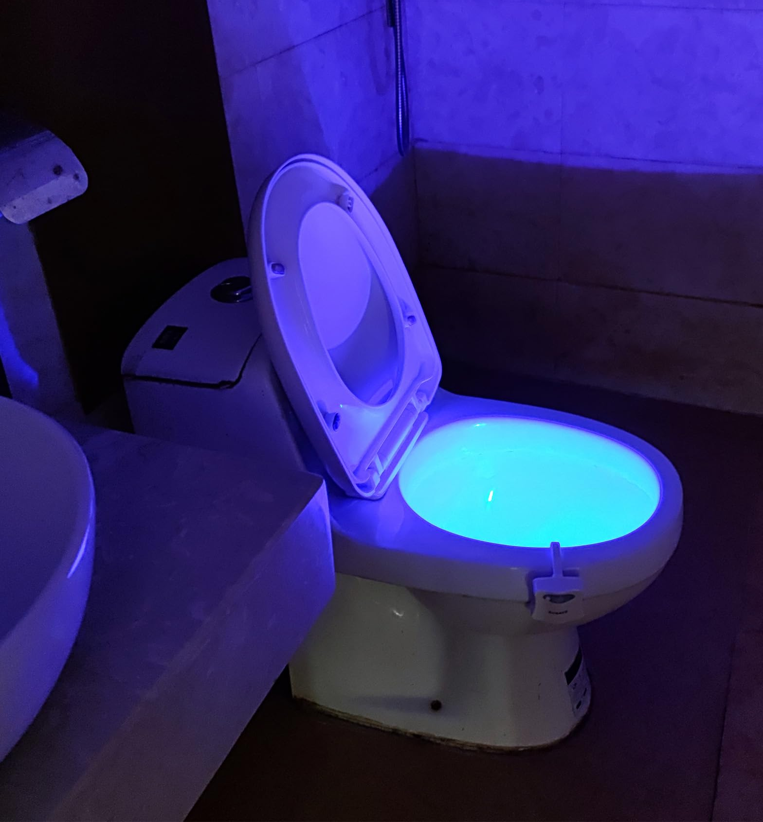
Why so Many Falls -
Common Things We Do
Not utilizing or installing appropriate lighting
Notes:
Presenter: Having good lighting is important to ensure we see fall hazards and things like changes in flooring or pavement, a wet floor, or objects in the way. Poor lighting, especially in staircases, increases the risk of a fall.
To improve lighting:
Change out any burnt-out bulbs as soon as they go out. If you can’t reach the bulb and don’t have good strength or balance to use a step stool, ask a friend, neighbor, or family member for help. Consider using LED lightbulbs as they last longer and don’t need to be changed out as often.
Put nightlights in hallways, bedrooms, and bathrooms.
Install additional lights in dimly lit places such as staircases.
Always turn on the lights before going up and down stairs or down hallways.
If you have light switches that are in odd-to-reach places, such as in the middle of a room, ensure you have a path free of clutter and other fall hazards to the switch(es).

Slide 14
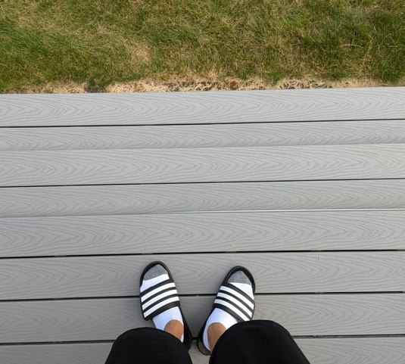
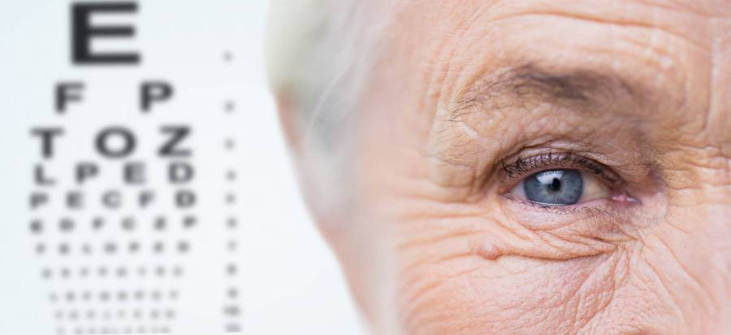
Why so Many Falls -
Common Things We Do
Not having our vision checked regularly, missing a step
Notes:
Presenter: Our vision changes as we age, impacting contrast sensitivity, glare, depth perception, peripheral vision, and requiring more light to see. Research shows that impaired vision more than doubles the risk of falls among older adults. Combined vision and hearing impairment further increase this risk, as both senses are crucial for balance and mobility.
Vision changes can be challenging. They may cause you to push yourself without accommodations or lead to isolation due to vision changes, which can increase the risk of falls. Reduced activity from isolation can lead to decreased muscle strength and balance, further heightening the risk.
Falls often occur from missing the last step or a slope because trifocals distort depth perception. Consider using separate glasses for distance and close vision. Simple changes like different lens colors in sunglasses can also help outdoors.

Slide 15
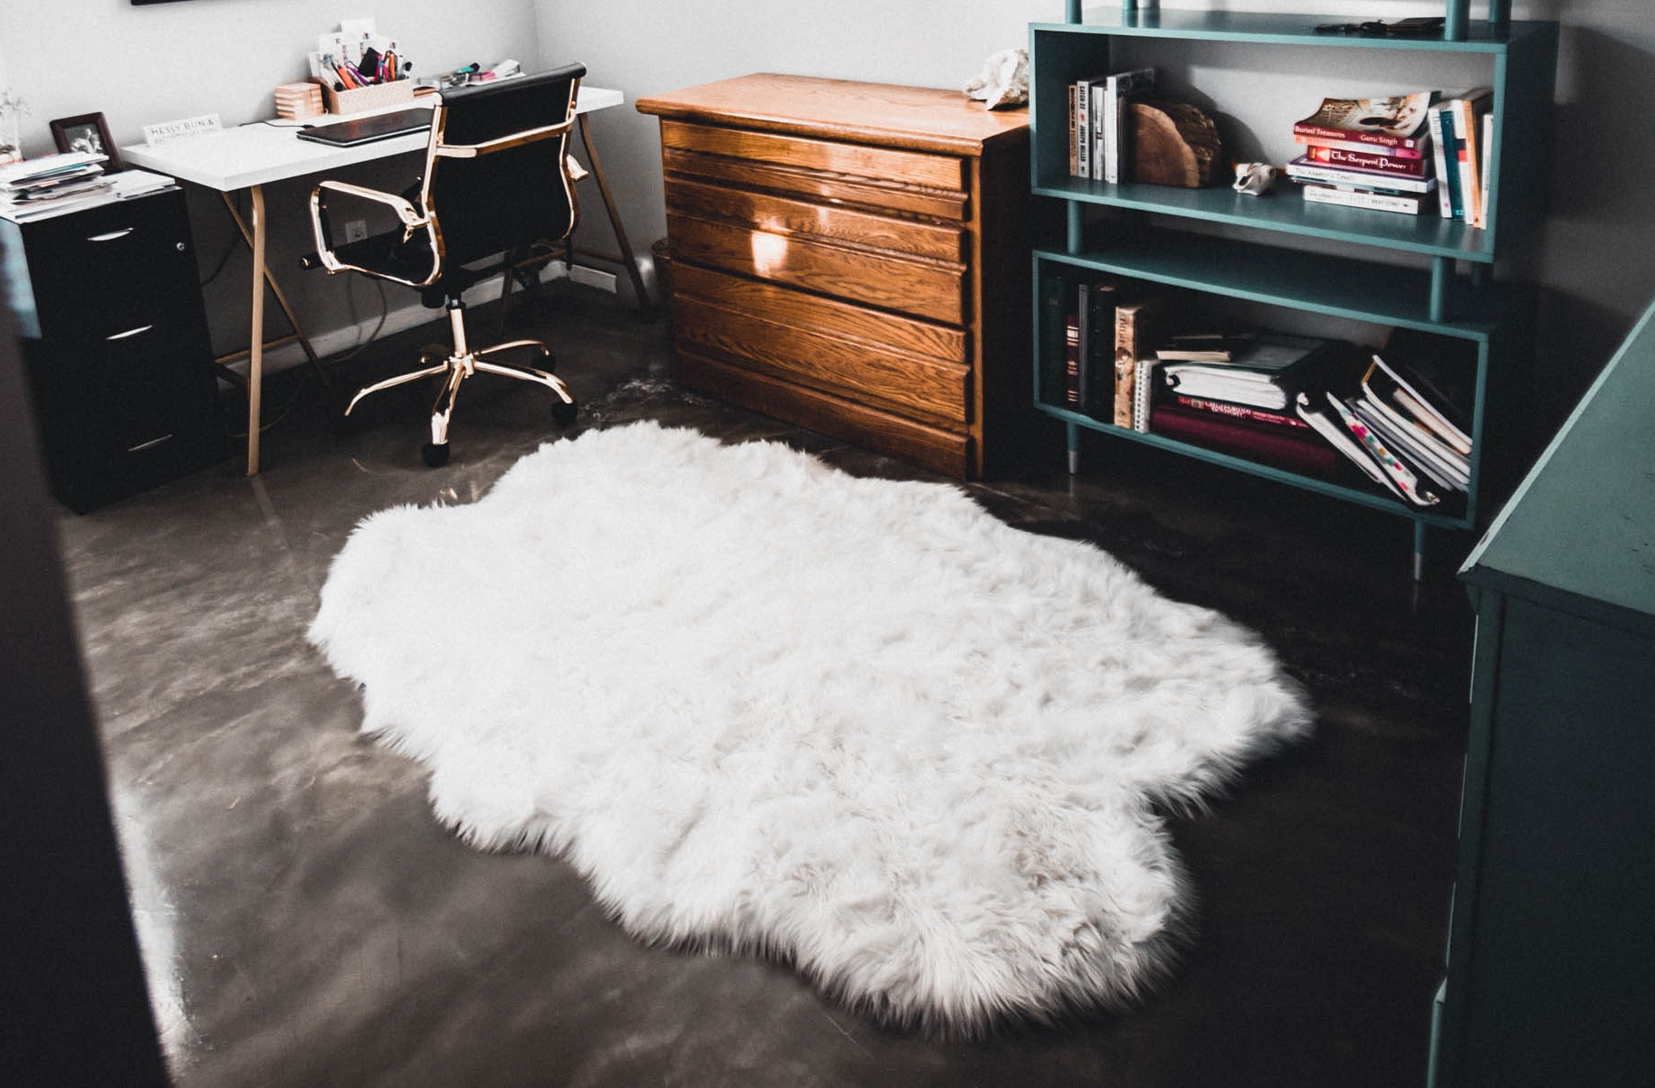
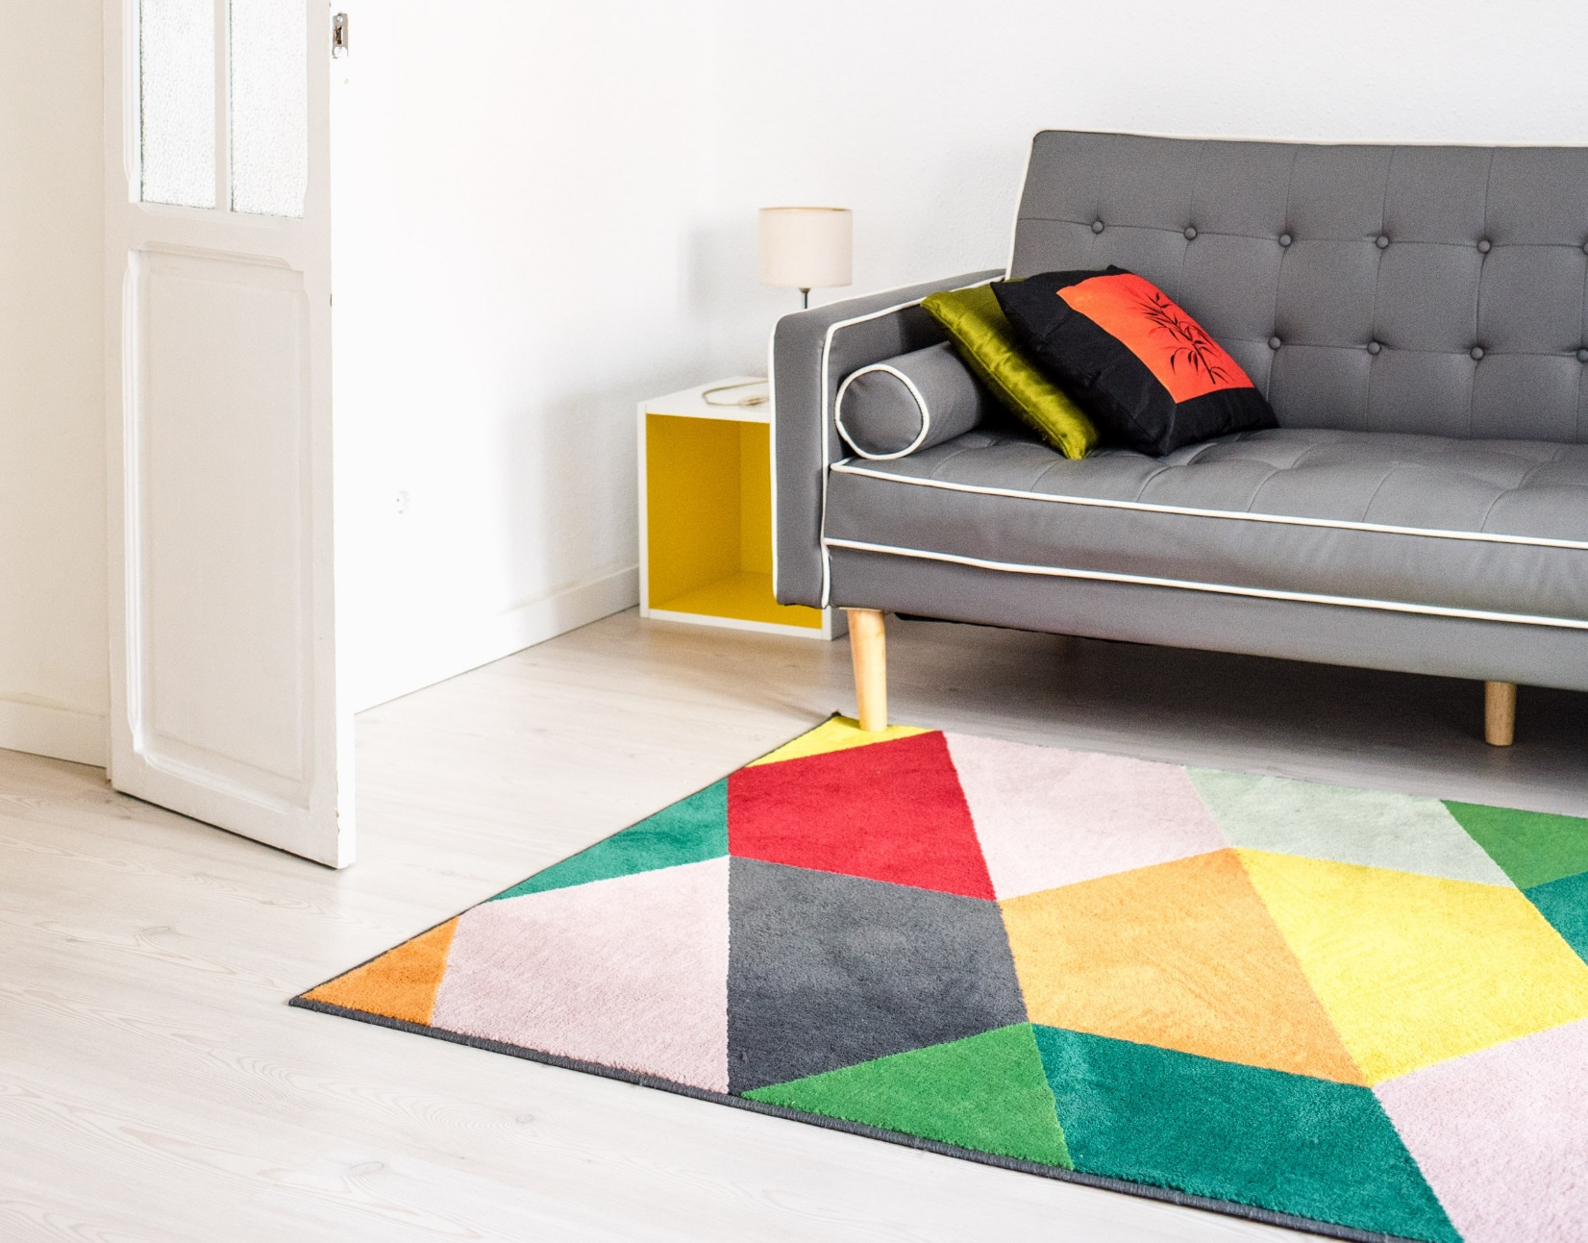
Why so Many Falls -
Common Things We Do
Throw rugs
Notes:
Presenter: Throw rugs are common fall hazards. They often bunch up, causing loss of balance and falls. Use mats with heavy-backed rubber bottoms to stay in place and avoid those with turned-up corners. If you use a cane or walker, you're at a higher risk of tripping over throw rugs, so it's best to remove them.
In the bathroom, use anti-slip adhesive safety strips instead of mats in the bathtub. Ensure bathmats have non-slip bottoms to prevent slipping.

Slide 16
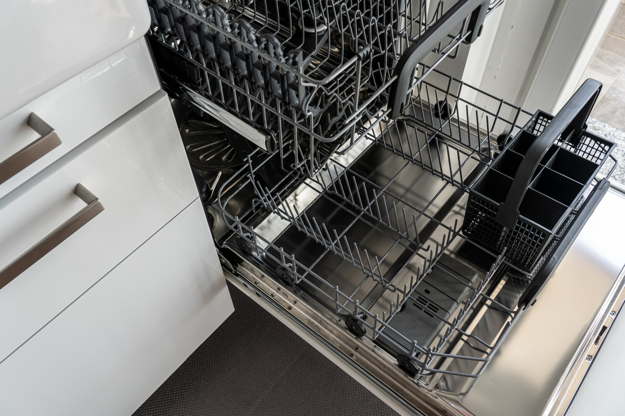

Why so Many Falls -
Common Things We Do
Unaware of our surroundings such as grandkids, pets and other objects underfoot
Notes:
Presenter: When you're in a hurry, you might not notice fall hazards like curbs or pets. Even if you're running behind, it's important to slow down and be aware of your surroundings.

Slide 17

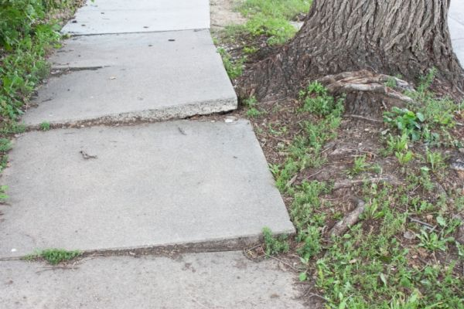
Why so Many Falls -
Common Things We Do
Distracted and not paying attention to where we are walking, and scanning ahead
Notes:
Presenter: Stay present in the moment. Avoid rushing and distractions, especially on uneven surfaces or in unfamiliar areas. Uneven pavement, grass, or sidewalks are common hazards. When walking, take your time and scan ahead. Consider using walking sticks or a cane for extra support, and be cautious on windy and rainy days. Some crosswalks without gritty texture can be very slippery when wet.
Have three points of contact no matter what you are doing. For example, if you are walking up your staircase or getting in and out of the shower, you want to have two hands and one foot or two feet and one hand in contact with something sturdy.

Slide 18
Why so Many Falls -
Common Things We Do
Nocturia - frequent nighttime urination
Lack of good lighting and clear pathway
Somethings to consider to help:
Commode by bedroom/in bedroom is bathroom is too far away
Incontinence supplies for nighttime use
Notes:
Presenter: Rushing can lead to falls. Whether you're hurrying to answer the phone, see who rang the doorbell, or even rushing to the bathroom, your risk increases as you may not be as attentive or aware of hazards. While avoiding rushing and taking your time is ideal, it can be challenging when you have to go to the bathroom. Bladder or bowel problems (incontinence) and decreased ability to "hold it" increase your fall risk.

Slide 19
Why so Many Falls -
Fear
Falls can create fear and increase the risk of another fall as individuals avoid activity, leading to a loss of strength and balance.
Notes:
Presenter: When people fall, they might get scared of falling again. This fear can make them stop doing activities that help keep them strong and balanced. When they avoid activity, they lose strength and balance, which actually makes them more likely to fall again. It's important to encourage safe, regular activity and help people overcome their fear of falling.
For example 3-5 weeks of inactivity can lead to 50% decrease in muscle strength.
Source: https://adaa.org/living-wtih-anxiety/older-adults/fear-of-falling, author Julie Loebeck Wetherall, PhD, Assoc Professor Dept of Psychiatry, University of California, San Diego, Anxiety & DePeression Association of America, May 2018

Slide 20
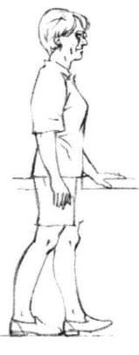
Why so Many Falls -
Loss of Balance
Proprioception - your body's ability to sense its position and movement in space.
How good is your balance?
Balance can be regained at any age!
Heel-toe Standing
Notes:
Presenter: There are Physical Therapists in our community who specialize in balance, known as Vestibular Therapists. Vestibular Therapy is a type of physical therapy that helps manage balance problems and dizziness. This includes dizziness, feeling unsteady or off balance, vertigo (spinning sensation), and issues with vision during head movements.
I am going to show you two examples of balance exercises, these are part of a 7-week program called Stepping On.
--Heel-Toe Standing: This exercise challenges your balance and is one of the most difficult for individuals. It's not about taking steps but holding your balance. Place one foot (the heel) directly in front of the other foot's toes and hold. Then switch feet and hold again. The closer together and more in a straight line your feet are, the harder it is to maintain balance.
--Heel-Toe (Tandem) Walking: Walk as if you're on a tightrope, placing one foot directly in front of the other and walking slowly. This exercise improves balance and is useful for navigating narrow areas, such as crowded stores during the holidays, bleachers at sporting events or concerts, and narrow paths to avoid ice.
_______________________________________________________________________
Other examples (not pictured) but time permitting sit-to-stand, sideways walking.
Sit-to-Stand: Practice moving from a seated to a standing position without using your hands. This exercise strengthens leg muscles and enhances your ability to get up from chairs, which is essential in daily activities.
Sideways Walking: Walk sideways by stepping one foot out and then bringing the other to meet it. This exercise improves lateral stability, helping you maintain balance when moving sideways through tight spaces or when avoiding obstacles.

Slide 21
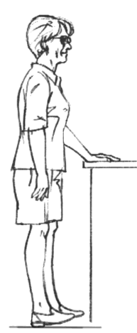
Why so Many Falls -
Loss of Strength
Strength can be regained at any age
How good is your strength?
Toe Raises
Notes:
Presenter: Loss of strength is closely related to falls prevention. One effective strength exercise is heel/toe raises. This exercise helps strengthen your ankles. If you are bumped or pushed from behind, your ankles will be the first to react to keep you upright.
Heel/Toe Raises:
Stand with your feet hip-width apart.
Slowly raise your heels off the ground, standing on your toes.
Hold for a few seconds, then lower your heels back down.
Next, raise your toes off the ground, standing on your heels.
Hold for a few seconds, then lower your toes back down.
Repeat this exercise 10-15 times for each set.

Slide 22
Why so Many Falls -
Medications
Several categories of drugs are recognized as Fall Risk Increasing Medications (FRIDS):
  Sedative/hypnotics used for sleep
  Antidepressants
  Benzodiazepines used for anxiety
  Antihistamines used for allergies
  Anticholinergics such as medication used to control bladder function
  Antipsychotic medications
  Muscle relaxants
  Medications used to control blood pressure
Notes:
Presenter: Certain medications can increase the risk of falling, including sleeping pills, anxiety or depression medications, and those that can suddenly lower blood pressure. If you take four or more different types of medications regularly, your fall risk may be higher. Ask your provider or pharmacist to review all your prescriptions, over-the-counter medicines, and supplements annually, or any time a medication is added or changed, to check if you are at risk for a fall.
In 2017, 94% of older adults received a prescription for a fall risk increasing drug (FRID), up from 57% in 1999. This increase in FRID use coincides with a more than doubling in the rate of fall-related deaths among older adults during the same medication,.
Source: The Washington Post: https://www.washingtonpost.com/health/elderly-falls-prescription-medication-risk/2021/06/10/989dd668-c30c-11eb-9a8d-f95d7724967c_story.html
_______________________________________________________________________
HANDOUT the medication list , explain Never stop taking a prescribed medication without consulting your doctor. If you notice a medication you're taking on the list, talk to your doctor about whether there is a less risky alternative that can provide the same benefit. Your doctor can evaluate the risks and benefits.

Slide 23
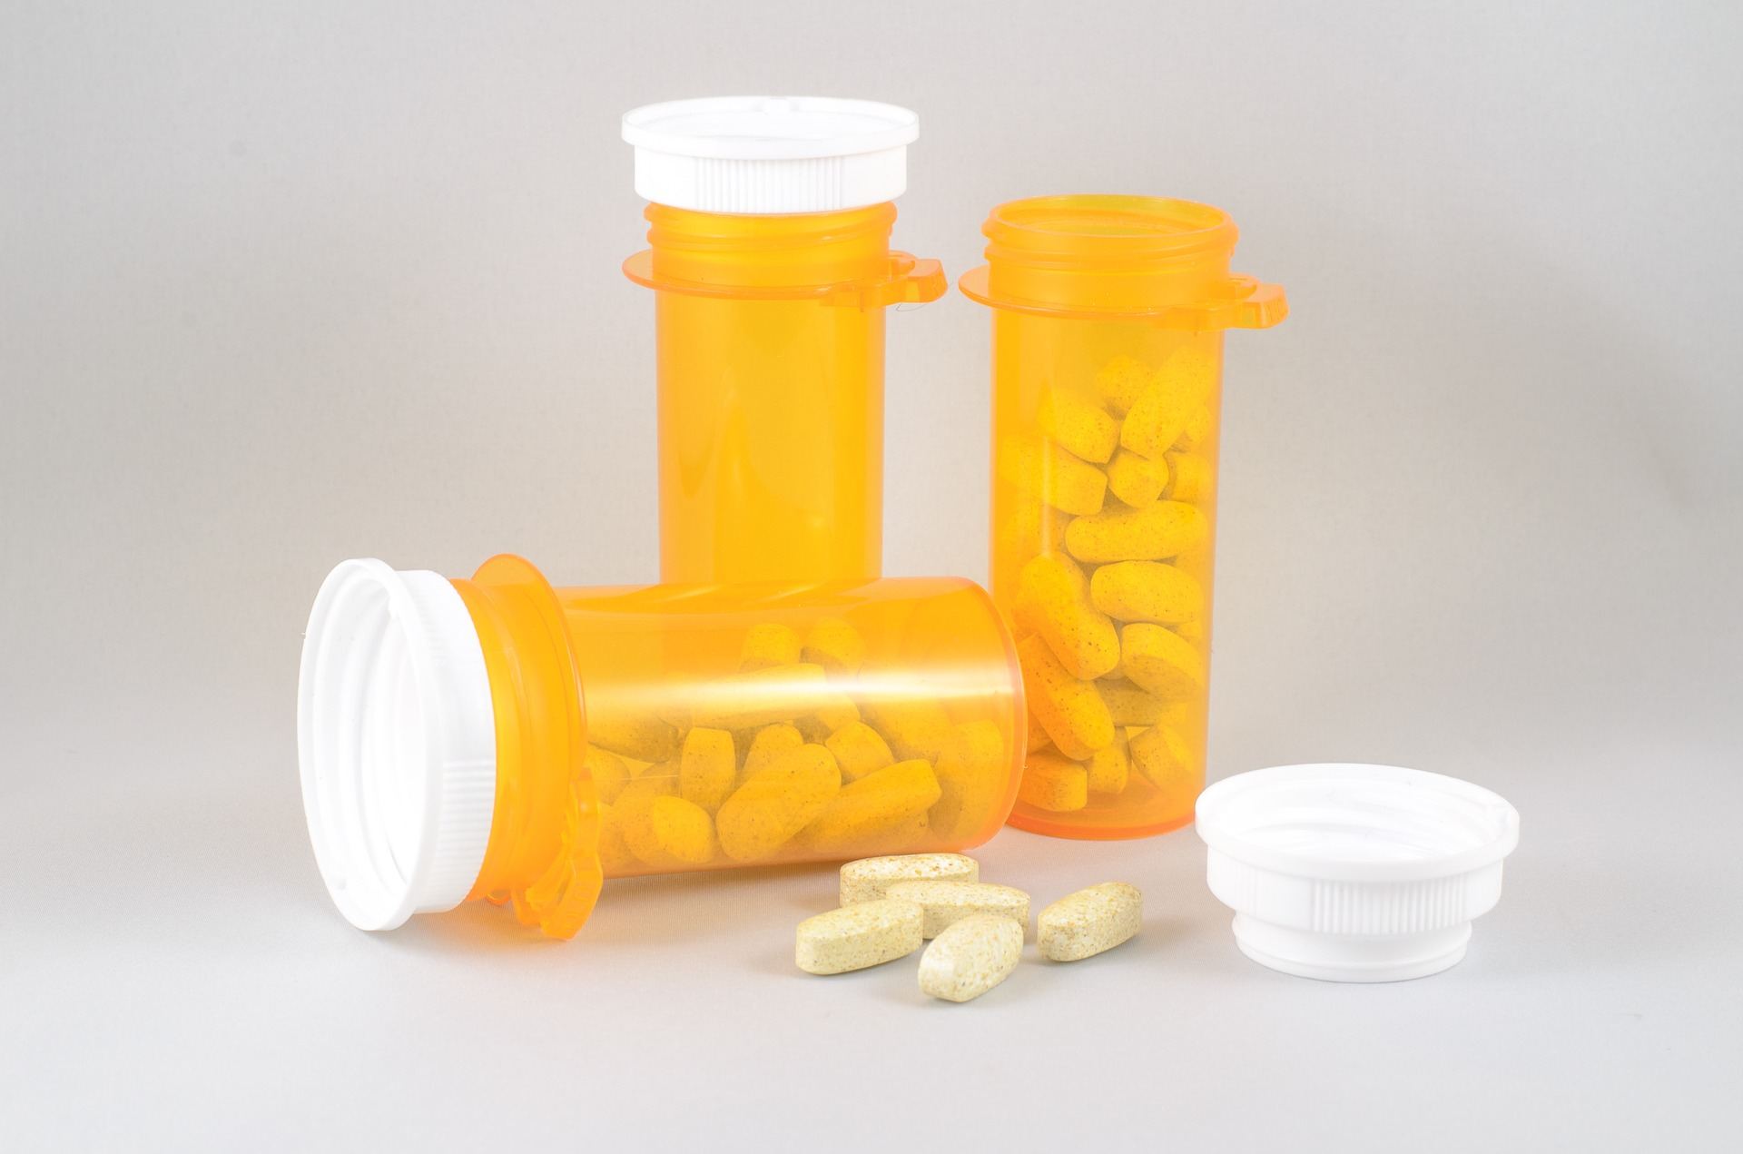
Why so Many Falls -
Medications
FRIDS are linked to falling. Why?
  FRIDS act in the brain, they can cause:
    Mental confusion
    Sedation
    Dizziness
    Impaired coordination
    Blurred vision
Notes:
Presenter: Some Fall Risk-Increasing Drugs (FRIDs) dilate blood vessels, causing orthostasis—dizziness that occurs when standing up too quickly from a seated position. This effect can contribute to falls in older adults.

Slide 24
Why so Many Falls -
Medications
Medications don’t metabolize in our body the same as they did if we took them when we were younger.
As we age, we're more likely to develop chronic conditions, which means taking more medications.
Notes:
Presenter: As we age, our body's ability to metabolize medications changes. This means that medications may not work the same way they did when we were younger. It is essential to regularly review medications with a healthcare provider to ensure they are still effective and safe.
With more medications, the chances of drug interactions and side effects increase. It's important to regularly review all medications with a healthcare provider to manage these risks effectively.

Slide 25

Why so Many Falls -
Over the Counter Medications
Over-the-counter drugs containing diphenhydramine, such as Benadryl, Tylenol PM, and Advil PM
Mixing medications with alcohol
Notes:
Presenter: Over-the-counter drugs containing diphenhydramine, such as Benadryl, Tylenol PM, and Advil PM, can also increase the risk of falls. These medications can cause drowsiness, dizziness, and impaired coordination, making it more likely for individuals, especially older adults, to experience falls.
Alcohol and other substances can increase your risk of falling, especially as you age. Your body may react differently to alcohol, affecting your reaction time, coordination, and balance. This risk is higher if you mix alcohol with your medications. Talk to your provider or pharmacist to ensure it’s safe.
Other substances like marijuana can also increase your fall risk and interact with your medications. Be mindful of how your body changes with age and how anything you consume might impact your risk of falling.

Slide 26
Ask Your Doctor & Pharmacist
Will a new medication increase my risk for falls?
Will it make me dizzy or drowsy?
Do I still need this medication?
Is there a safer alternative?
Is this medication still the appropriate dose at my age?
Will it interact with OTCs I’m taking?
If I realized I missed a dose, should I still take it?
Notes:
Presenter: Here are some questions you can consider asking your doctor or pharmacist about your medications.
*Encourage the audience to review this slide and prepare for their next visit with their provider. These questions are also listed on the medication handout.

Slide 27
Why so Many Falls -
Medical Conditions
Heart arrhythmia
Orthostatic hypotension (low blood pressure from sudden change in position)
Seizures
Parkinson’s
MS
Low blood sugar from diabetes
Vertigo
Arthritis
Notes:
Presenter: Many medical conditions can increase the risk of falling, particularly those that affect balance, mobility, or vision.
Balance: Diabetes can reduce feeling in the feet, and strokes can affect balance. Other conditions that impact balance include heart disease, thyroid problems, nerve issues, and problems with the feet or blood vessels.
Mobility: Conditions like sarcopenia (age-related loss of muscle mass) can make it harder to walk, get up from a chair, or step up onto a curb.
Vision: Impaired vision can increase the risk of falling.
Additionally, medications you might be taking for these conditions can further contribute to fall risk.

Slide 28
If You’ve Fallen
Assess how it happened?
Determine how to avoid?
How can I change this from happening again?
Notes:
Presenter: We talk a lot about how to prevent falls but what about if you do fall?
If you fall, it's important not to panic and to avoid getting up too quickly. Take a few moments to determine if you are injured. If you aren't injured, you can attempt to get up, but be sure to use stable furniture for support. If you are injured, call for help. Understanding the cause of your fall is also crucial. Consider if you had a drop in blood pressure, recently started a new medication with side effects, or if something like a throw rug caught on your slippers. It's important to discuss the potential causes of your fall with your provider and find ways to prevent future falls.

Slide 29
Resources
Identify where you/your loved one can remove any risk for falls. Fall risk self-assessment: https://www.ncoa.org/article/falls-free-checkup
Falls Free Wisconsin: https://fallsfreewi.org/
  Interactive Home Safety Challenge
  Falls Free Checklist Tool and more!
Talk about it and share - to your doctor, pharmacist, family, or friends as falls can be prevented with, often, simple adjustments. We learn from each other.
Notes:
Presenter: Most people may avoid talking to their doctor about falls prevention until they've experienced one with an injury because falling can be embarrassing or hurt our pride. However, the consequences of not addressing falls can be much worse, leading to significant injuries or loss of independence. When others know about a fall or concern, it can create worry about continuing to live safely at home. Sharing this information with someone can help develop strategies to prevent future falls and ensure safety.

Slide 30

Initiatives from Our Group:
Referral Program Partnership with Local EMS: Collaborating with emergency medical services to ensure timely and appropriate referrals.
Quarterly Falls Prevention Program Listing: Providing updated listings of falls prevention programs every quarter.
Falls Prevention Resource Guide: Offering a comprehensive guide with resources to help prevent falls.
https://adrcofbrowncounty.org/fall-prevention/
Notes:
Presenter: The statistics around falls highlight the importance of falls prevention, which is why various organizations meet regularly to address these issues and provide resources. By coming together, these groups can share insights, develop strategies, and ensure that effective measures are in place to help prevent falls and support those at risk. This collaborative approach helps create a safer environment for everyone, especially older adults who are more vulnerable to falls.

Slide 31
ANY QUESTIONS?

Slide 32
THANK YOU!

