Slide 1

Prevent Falls As You Age
Take Control of Your Health!

Slide 2
Agenda
Introduction to organization
Falls risk overview
Wisconsin falls data
Tips to help prevent falls
Falls Free Wisconsin initiative
Q&A
Notes:
Add local falls data if you have it

Slide 3
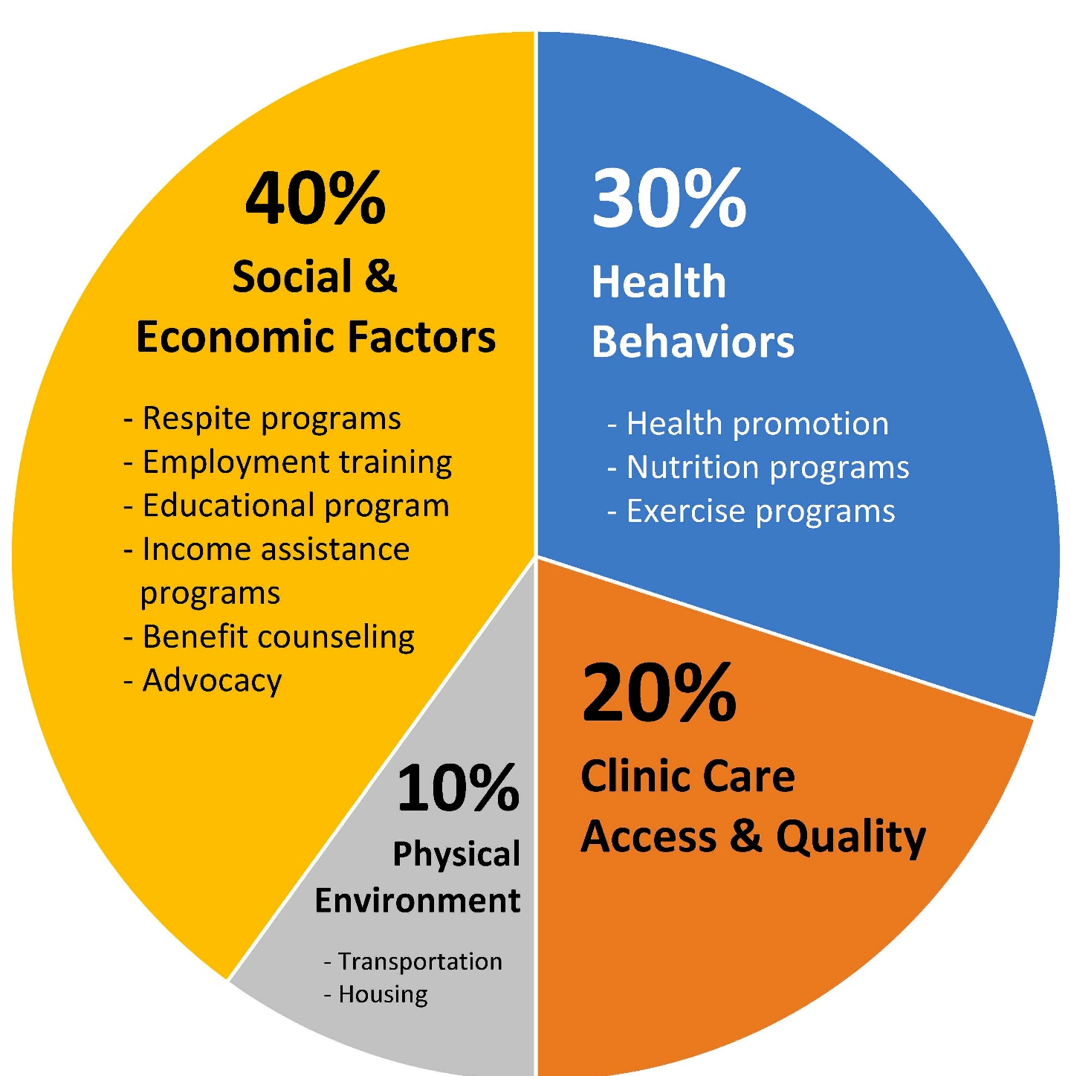
Determinants of Health
Source: County Health Rankings model - University of Wisconsin Population Health Institute (2016)
Notes:
Usually think that a doctor’s office contributes a lot to our health, but in reality, it’s only a small 20%. What contributes more is social & economic factors and health behaviors- that’s what you’re doing to take care of your health including eating well and exercising. So that’s where WIHA comes into play.

Slide 4
About Organization…
Text
Mission/Vision/etc.,

Slide 5
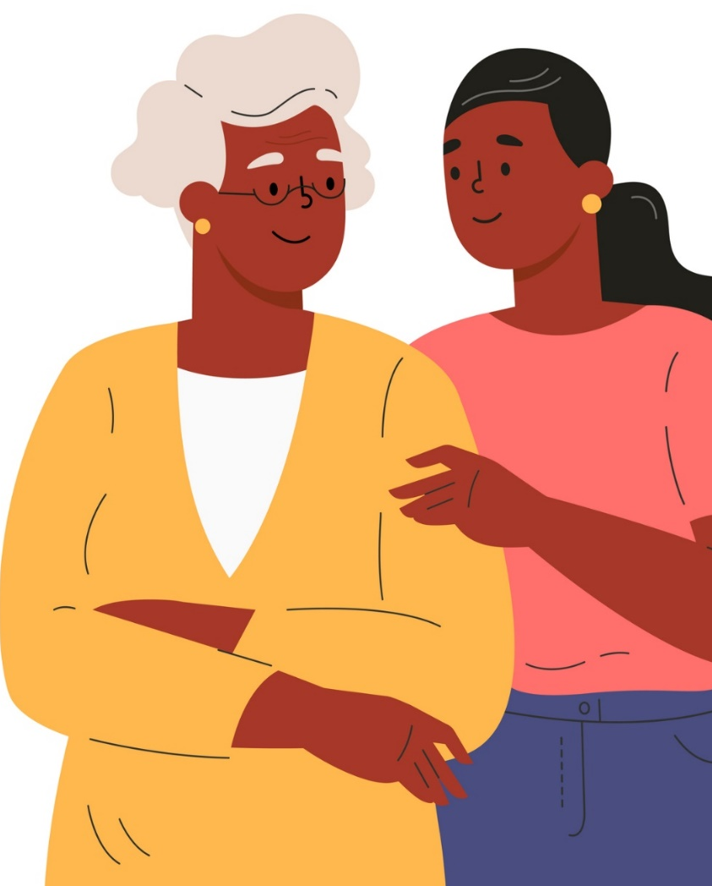
What causes someone to fall?
Share your thoughts!
Notes:
Discussion – what causes someone to fall?
What Conditions Make You More Likely to Fall? (https://www.cdc.gov/falls/facts.html)
Research has identified many conditions that contribute to falling. Many risk factors can be changed or modified to help prevent falls. They include:
Lower body weakness
Vitamin D deficiency (that is, not enough vitamin D in your system)
Difficulties with walking and balance
Use of medicines, such as tranquilizers, sedatives, or antidepressants. Even some over-the-counter medicines can affect balance and how steady you are on your feet.
Vision problems
Foot pain or poor footwear
Home hazards or dangers such as
broken or uneven steps, and
throw rugs or clutter that can be tripped over.
Most falls are caused by a combination of risk factors. The more risk factors a person has, the greater their chances of falling.

Slide 6
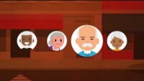
Falls Prevention
Notes:
https://youtu.be/OLZX8_oDLOk

Slide 7

The Falls Problem…
Every 11 seconds, an older adult is seen in an emergency department for a fall-related injury.
Over 800,000 patients a year are hospitalized because of a fall injury.
In 2015, the total medical costs for falls was more than $50 billion. Medicare and Medicaid shouldered 75% of these costs.
More than 95% of hip fractures are caused by falling (usually by falling sideways).
Source: Centers for Disease Control & Prevention (CDC)
Notes:
Nationwide

Slide 8
The Falls Problem…
In 2021, there were 43,004 ED visits due to falls among those 65 and older in WI – a 12% increase from 2020.
Wisconsin has the highest rate of deaths due to older adult falls in the country according to the CDC: 1,785 reported in 2020 - up nearly 10% from 2019.
Source: WI DHS – WISH data (2021)
Notes:
In Wisconsin

Slide 9
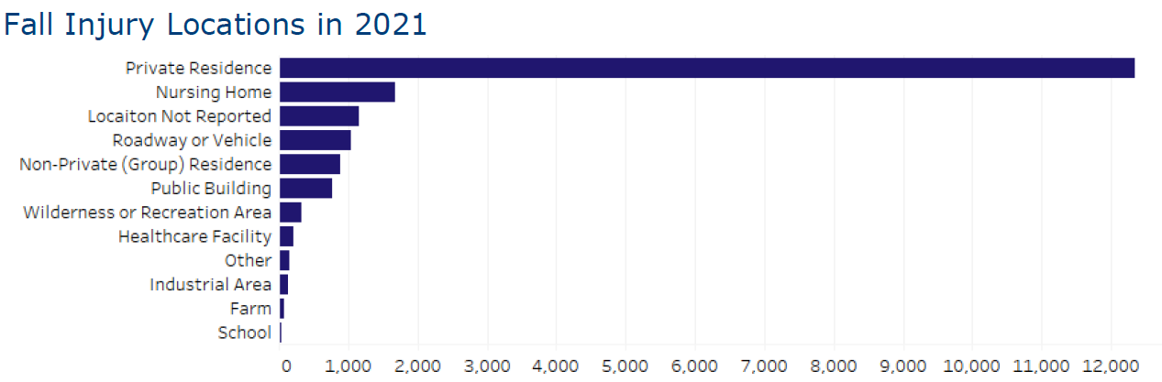
The Falls Problem…
Most older adult falls happen in the home.
Source: WI DHS – Division of Public Health (2021)

Slide 10
The Falls Problem…
Notes:
Add local data if you have it or delete this slide

Slide 11
Consequences of Falls…
Broken bones
Head injuries
Difficulty with daily activities
Fear of falling
Notes:
Head injuries can be very serious, especially if someone is taking certain medicines like blood thinners
Fear of falling can cause someone to cut down on their everyday activities. When you’re less active, you become weaker and this increases your chance of falling

Slide 12
Many falls are preventable
Let’s talk about how to reduce your falls risk!
Notes:
Discussion – how can you prevent falls?

Slide 13
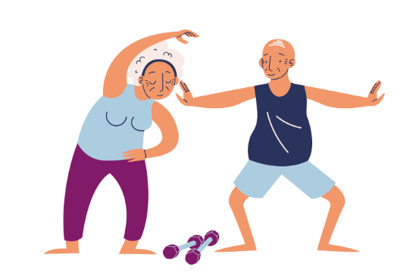
Let’s Get Moving
Find a balance and exercise program
Notes:
Like Tai Chi, Strong Bodies, etc.,
Slides 13-55 adapted from NCOA’s 6 Steps to Prevent a Fall PowerPoint

Slide 14
As we age, it is common to feel unsteady or start to have a fear of falling. The good news is, there are many programs available that are proven to help decrease the risk of falls. Some physical activity and exercise programs can improve balance, strength and flexibility.

Slide 15
Find a good balance and exercise program
Do exercises regularly
If you were referred to a physical therapist to prevent falls, do your exercises as recommended.

Slide 16
Find a good balance and exercise program
Visit your local Aging & Disability Resource Center (ADRC) or senior center
The ADRC may offer information on its website, or you can give them a call to find out what balance and exercise programs are available nearby. Many offer a variety of programs and activities for people to join.

Slide 17
Find a good balance and exercise program
Bring a friend!
Trying something new can be intimidating. Once you find a program that looks promising, take a friend or caregiver with you!
You will have more fun and you’ll be able to motivate each other.

Slide 18
Find a good balance and exercise program
Don’t forget online options
Many physical activity programs are now available online.
You may be able to participate in balance or exercise programs without leaving the comfort of home.

Slide 19
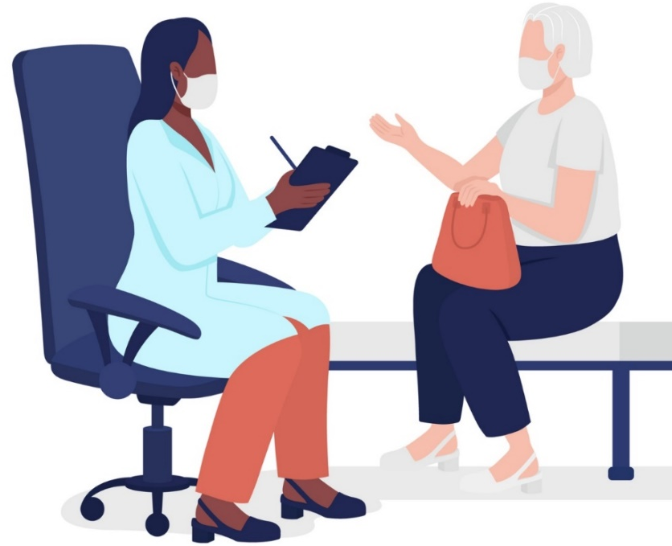
Talk to Your Provider
Have honest conversations about falls

Slide 20

More than 1 in 4 older adults falls each year, but only half tell their provider. It is important for your provider to know about any health problems, but you should also let them know your concerns about balance and falls.

Slide 21
Talk to your provider
Write a list of things you want to talk about
Before your appointment, create a list of health topics you want to talk about, including balance and falls. This outline will help you remember your conversations points and questions.

Slide 22
Talk to your provider
Ask for a falls risk assessment
If you have fallen, have trouble walking, or feel unsteady, talk to your provider about having a falls risk assessment.

Slide 23

Talk to your provider
Talk about other specialists
Ask your doctor if you would benefit from seeing a physical or occupational therapist, or other specialists to help improve balance, strength, medication use, vision and hearing to reduce your risk of falls.

Slide 24
Talk to your provider
Be honest about your concerns
Tell your doctor if you have fallen and share as many details as possible. The more your doctor knows, the more they can help you.

Slide 25
Talk to your provider
Take notes – and ask for notes!
Bring a notepad and pen to write down any important information your provider shares with you. You could also ask if you can record the appointment so you can go back and listen. This helps to remind you of information shared during the appointment.
Notes:
Bring a loved one with to your appointment

Slide 26
Talk to your provider
Ask questions
If there is anything you don’t understand, ask your provider to clarify. You could also repeat information back to the provider to help you remember and let them know you understand the information.

Slide 27

Review Medications
Learn more about your medications and falls risk

Slide 28
Many people take more than one prescription and use over-the-counter medications. As we age and our bodies change, taking multiple medications increases the chance of side effects, drug interactions and risk of falling.

Slide 29
Review your medications often with ALL your health care providers – including your doctor and pharmacist – to make sure your medications are not increasing your risk of falls and other problems.

Slide 30
Regularly review your medications
Take medications only as prescribed
Follow medication instructions such as when to take, how often, how much, and with or without food. Don’t skip doses, take multiple doses, or take any medications that weren’t prescribed to you.

Slide 31
Regularly review your medications
Keep a list of your medications
Keep an up-to-date list of all your medications, including prescriptions (those taken by mouth, applied to the skin, eye drops and injectables), over-the-counter medications, herbal supplements, and vitamins and minerals.

Slide 32
Regularly review your medications
Set reminders for a medication review
Bring your medication list to your provider or pharmacist and have them reviewed at least once a year AND whenever a new medication is added or your health changes. Ask questions about your medications.

Slide 33
Regularly review your medications
Report side effects
Some medications can cause side effects like:
Feeling dizzy or woozy
Sleepy during the day, or confused
Needing to urinate more often
Affecting coordination in your legs
Talk to your provider if you are experiencing these problems.

Slide 34
Regularly review your medications
Stick to one pharmacy
Using one pharmacy will keep you safer as the pharmacist tracks all the medications you are taking. They can contact your provider if they identify any medications that do not work well together, that may be a duplicate of another medication you are taking, or if you have been prescribed too high a dose.

Slide 35
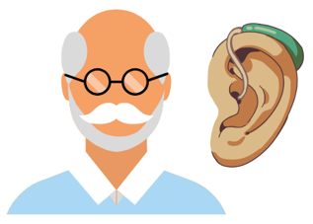
Vision and Hearing
Take care of your vision and hearing

Slide 36
Being able to see and hear well is important for good balance. Poor vision and hearing loss can increase the risk of falls.

Slide 37
Get your vision and hearing checked annually
Get an eye exam every year
Have a dilated eye exam once a year to update your glasses and to detect eye diseases, like cataracts and glaucoma. Early detection can help protect vision and prevent vision loss and falls.

Slide 38
Get your vision and hearing checked annually
Wear glasses properly
Use prescribed glasses and avoid wearing sunglasses inside.

Slide 39
Get your vision and hearing checked annually
Be safe while wearing bifocals
Bifocals can make your vision blurry when navigating steps, curbs or edges, especially outside. If you wear bifocals, tuck your chin in when stepping over curbs and on stairs to look through the distance portion of your glasses, which provides a clearer view.
Notes:
If you have bifocal or progressive lenses, you may want to get a pair of glasses with only your distance prescription for outdoor activities, such as walking. Sometimes these types of lenses can make things seem closer or farther away than they really are.

Slide 40
Get your vision and hearing checked annually
Check for hearing changes
Get a hearing test once a year and receive treatment if any hearing loss is identified. Hearing tests are available online and hearing aids for mild to moderate hearing loss are sold over-the-counter in retail stores and pharmacies.

Slide 41
Get your vision and hearing checked annually
Light it up!
Add a nightlight to the bedroom, bathroom and hallway to help you navigate in the dark and find the light switch.

Slide 42

Home Safety
Make your home safer

Slide 43
Thousands of older adults fall at home each year due to common household hazards. Make sure your home is safe and help prevent falls by following a few easy tips.

Slide 44
Keep your home safe
Clear the way
Remove tripping hazards like throw rugs, cords, or clutter on the floor. Move furniture to create a path for safe movement.

Slide 45
Keep your home safe
Light it up
Replace lightbulbs with bright, non-glare bulbs to help you see around the house.
Add extra lights in dimly lit places.

Slide 46
Keep your home safe
Have a seat
Place a chair in your bedroom and entryway so you can sit while getting dressed or putting shoes on.

Slide 47
Keep your home safe
Secure some support
Upgrade your bathroom: use a shower chair, add grab bars in the bath/shower and by the toilet and use an adjustable-height handheld showerhead to make bathing easier.

Slide 48
Keep your home safe
Store for success
Keep frequently used items between waist and shoulder height, making them easier to access without the need for a stepstool or unsafe reaching.

Slide 49
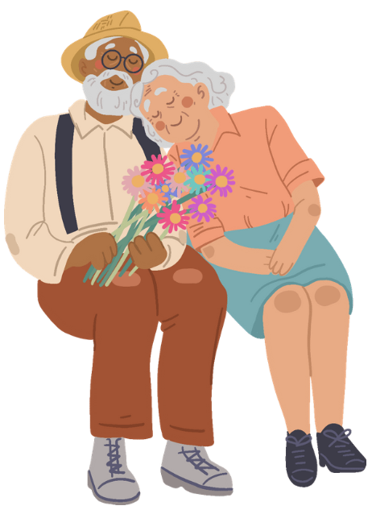
Talk About It
Talk to your loved ones about preventing falls

Slide 50
Family and friends can play an important role in keeping you falls free. They support you for events in your life and can also help you be independent and safe from falls.

Slide 51
Talk to your loved ones
Start off small
Have a one-on-one conversation with a trusted friend or family member about your concerns about falls. They might have ideas and solutions.

Slide 52
Talk to your loved ones
Ask for help and be specific
The more information you share, the more your loved ones can help you. Ask them to help you find information that would be most helpful to you.

Slide 53
Talk to your loved ones
Involve them in your care
Share with your loved ones any upcoming medical appointments, what medications you are taking, and any current problems or concerns you have.

Slide 54
Talk to your loved ones
Keep talking
One conversation is often not enough. Keep revisiting the topic with your loved ones and let them know if your needs change or grow.

Slide 55
Talk to your loved ones
Be assertive!
Be clear and confident as to what you need. Ask your loved ones to help you with actions you are taking to prevent falls, such as adding grab bars in the bathroom or encouraging you to do balance and strength exercises.

Slide 56


Take an Evidence-Based Falls Prevention Program
Notes:
https://wihealthyaging.org/programs/find-a-workshop/
Stepping On is proven to reduce falls by 31%! The workshop meets for 7-weeks, once a week for 2 hours. It is led by trained facilitators and there are physical therapists, pharmacists and other experts that attend throughout the 7 weeks. You will learn practice balance and strength exercises, learn more about home fall hazards, vision and footwear, medication management, sleeping better, vitamin D & calcium, travel safety and more
Add local workshop dates if you have a workshop scheduled

Slide 57
Falls Free Wisconsin
A Collaborative Approach to Reducing Falls in Wisconsin
Saving lives. Preserving independence.
Reducing costs.
Notes:
Address root causes of falls. Promotes programs but also practices that reduce falls risk. While falls are a leading cause of injury, hospitalization and institutionalization for older adults, they don’t have to be a normal part of aging. There is a falls prevention coalition that works on falls prevention statewide. Encourage participants to visit fallsfreewi.org

Slide 58
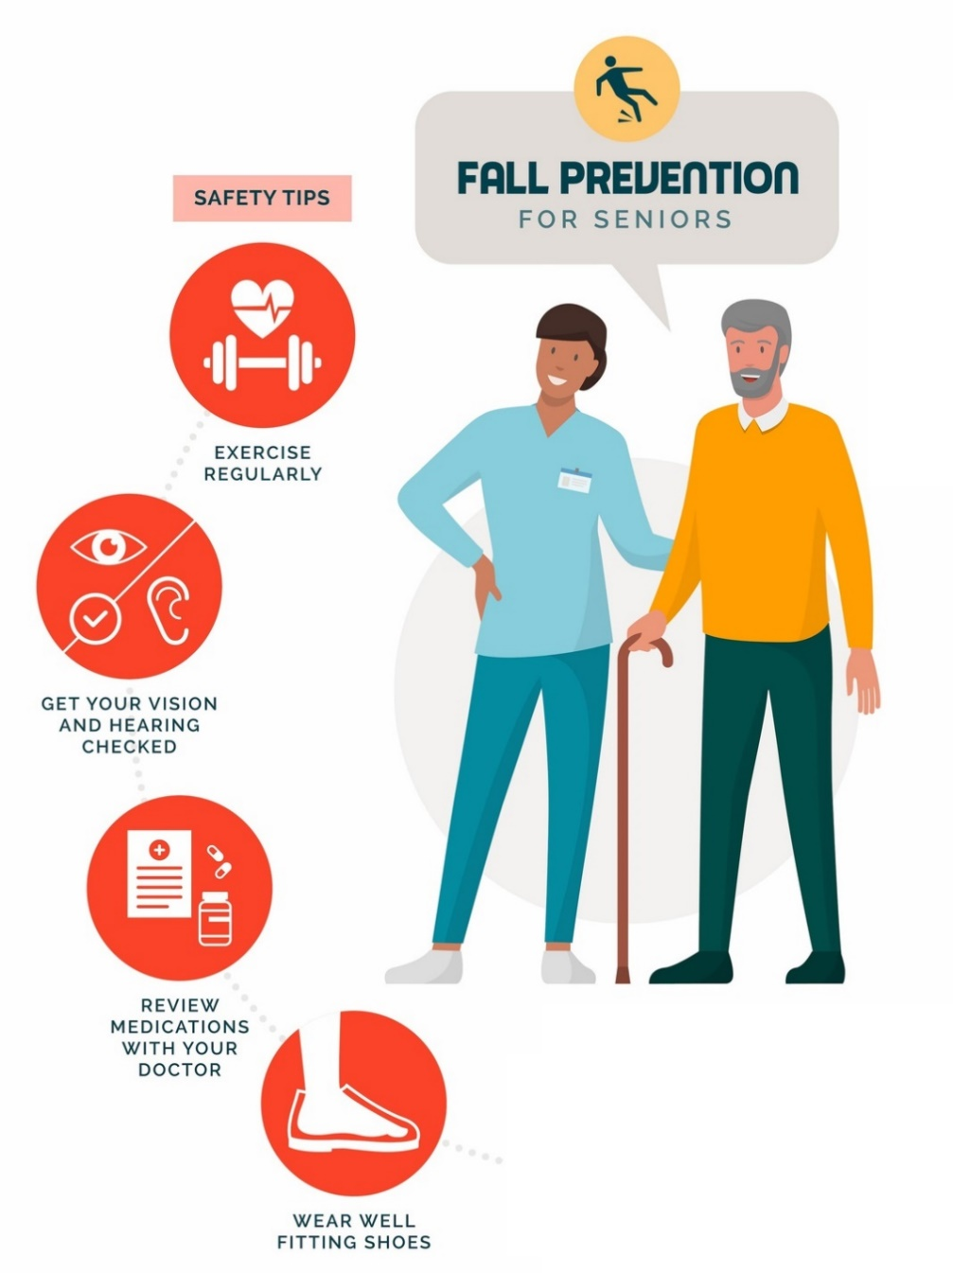
Making a Difference – Falls Free Wisconsin A positive, upbeat, you-can-do-it website to find falls prevention information, strategies, programs and motivation.
Printable content addressing falls factors
Planning tools for safety and mobility
Virtual home safety walk-through to identify home hazards and how to eliminate them
Interactive quizzes to teach falls prevention strategies
Relatable stories both text and video
Access to evidence-based falls programs
Notes:
There is also information for professionals like pharmacists, community organizations and health care providers on how they can help prevent falls.
Go to website or insert screenshots

Slide 59
Recap: What Can You Do to Prevent Falls?
Get moving!
Talk to your provider
Review your medications
Take care of your vision and hearing
Keep your home safe
Talk about it!
Visit the Falls Free Wisconsin website (fallsfreewi.org)
Want to learn more? Take a Stepping On falls prevention class!

Slide 60

Questions?

Slide 61

Contact
Name
Title
Phone
Email

